Slide 1
exo-matriz
A fabulative simulation game about land, culture, resources and beetles

Slide 2
Team
Fime de la Fuente
Sacha kavanagh-sommerer
Leonardo Morales Vega

Slide 3
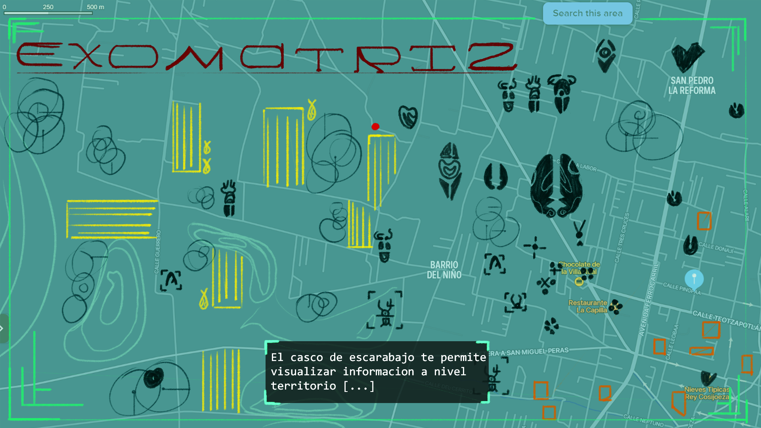

Slide 4
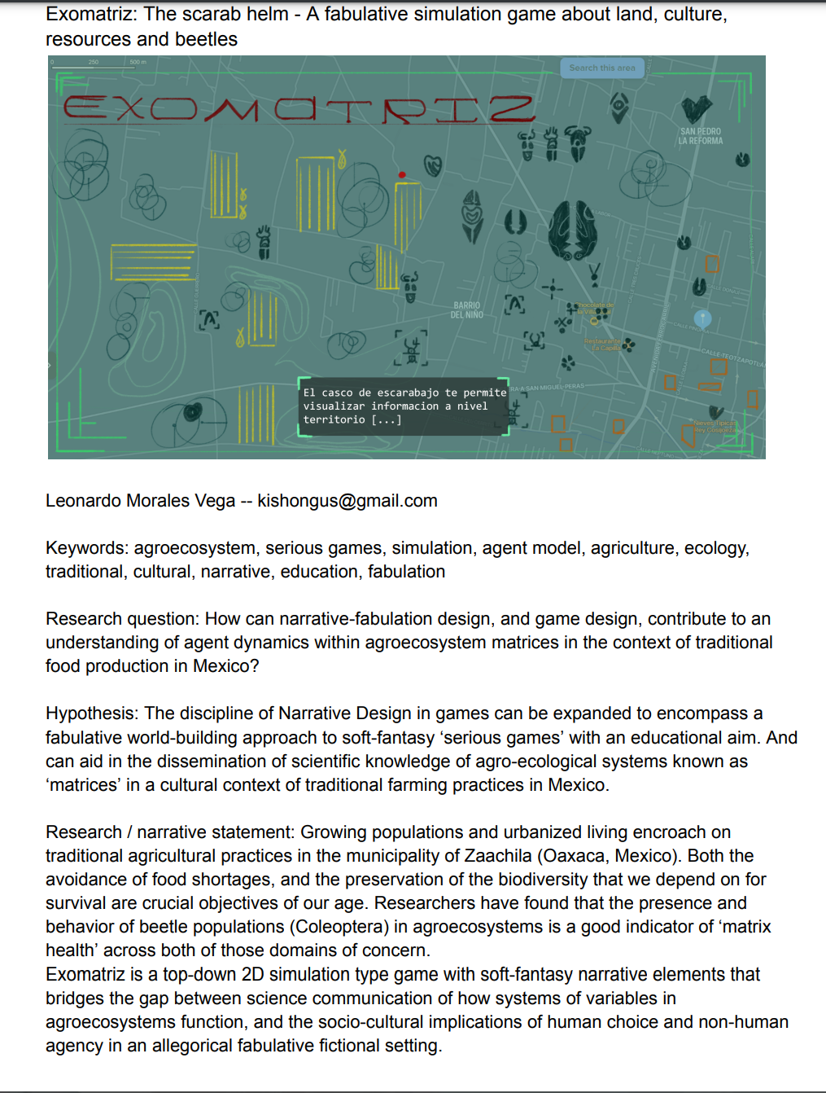
Research objectives
How can narrative-fabulation design, and game design, contribute to an understanding of agent dynamics within agroecosystem matrices in the context of traditional food production in Mexico?
Exo-matriz is a top-down 2D simulation type game with soft-fantasy narrative elements that bridges the gap between science communication of how systems of variables in agroecosystems function, and the socio-cultural implications of human choice and non-human agency in an allegorical fabulative fictional setting.

Slide 5
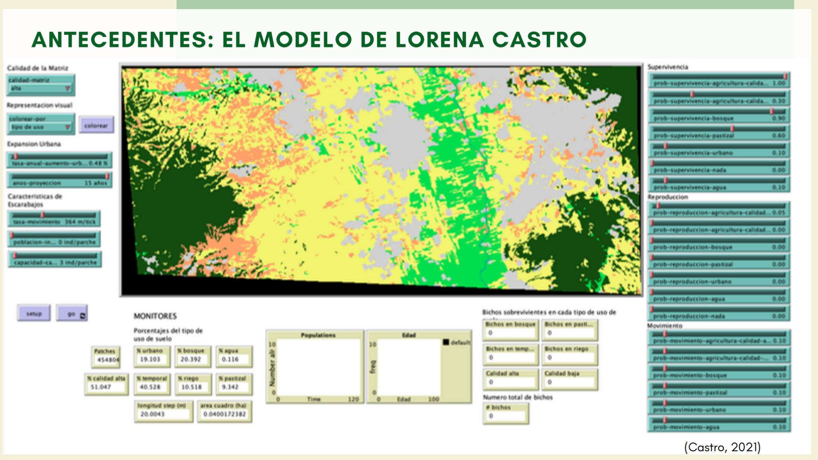
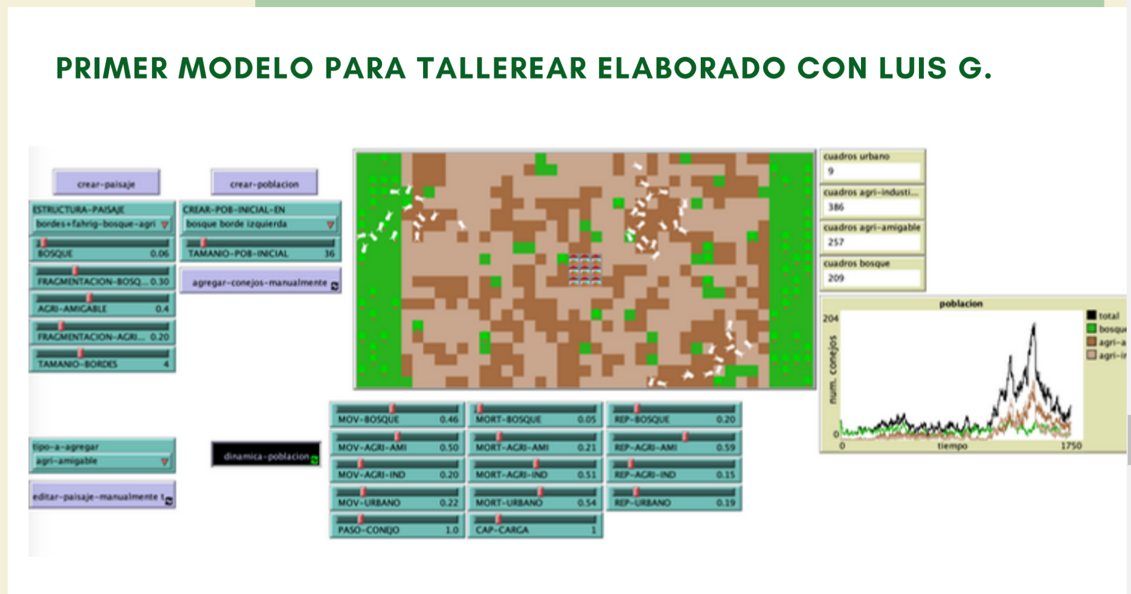
Antecedents
Lorena Castro’s original model based on Zaachila data.
Luis G.’s workshop pedagogical model.

Slide 6
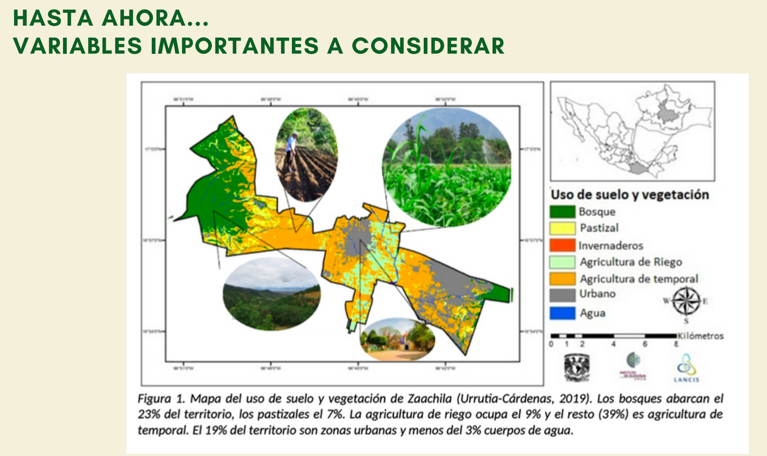
Diagram from Lorena Castro’s paper on the agro-ecological matrix in Zaachila.

Slide 7
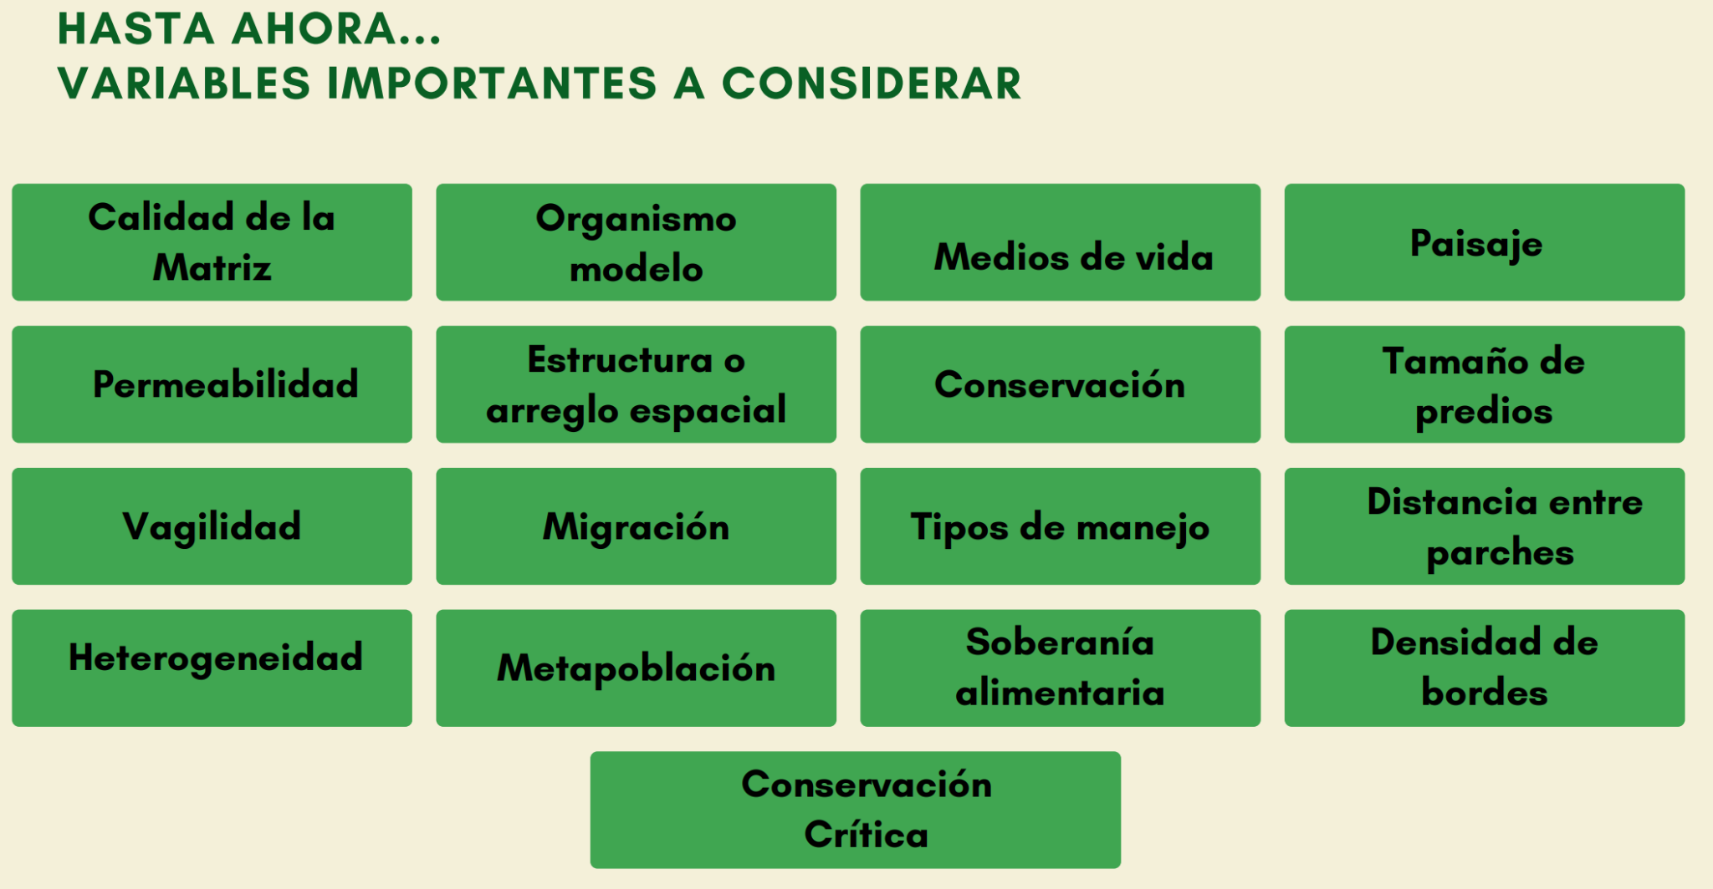
Evaluation of variables
Matrix quality
Model organism (coleoptera)
Ways of life.
Landscape
Permeability
Structural layout
Conservation
Property size
Vagility
Heterogeneity
Migration
Metapopulation
Food sovereignty
Types of land use
Population density
Critical conservation
Border density

Slide 8
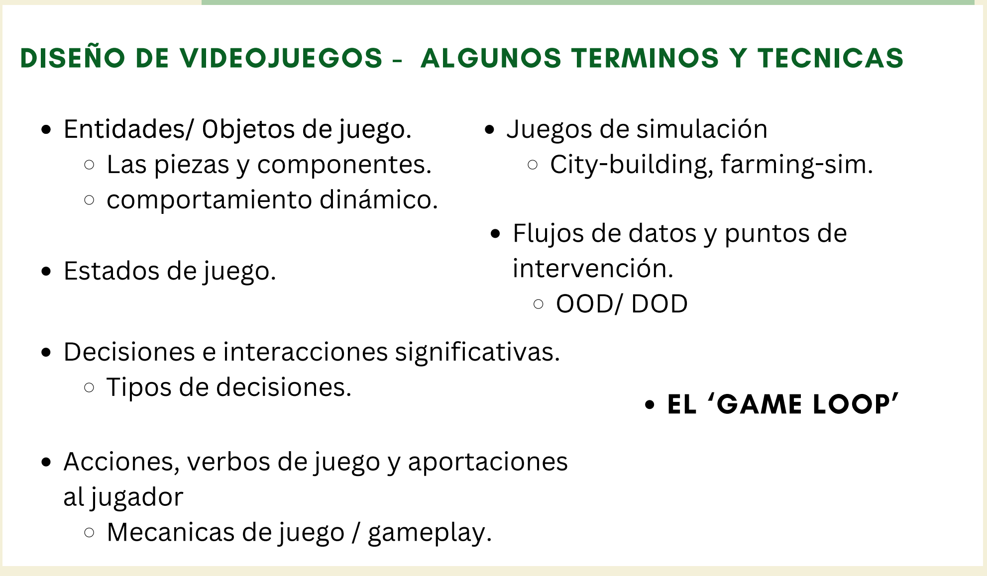
Game design
objects/ entities
Simulation games
Data flows and intervention points
Game states
Significant decisions
Action verbs, affordances
The game loop

Slide 9
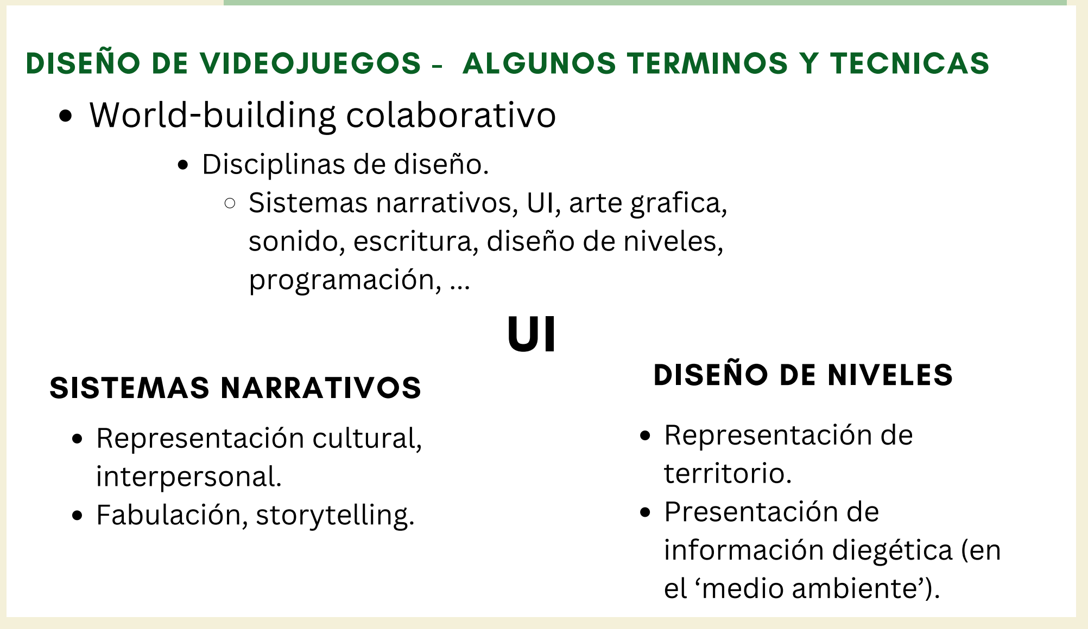
Collaborative Worldbuilding (after Kaitlin Tremblay).
UI
Narrative systems
Level design

Slide 10
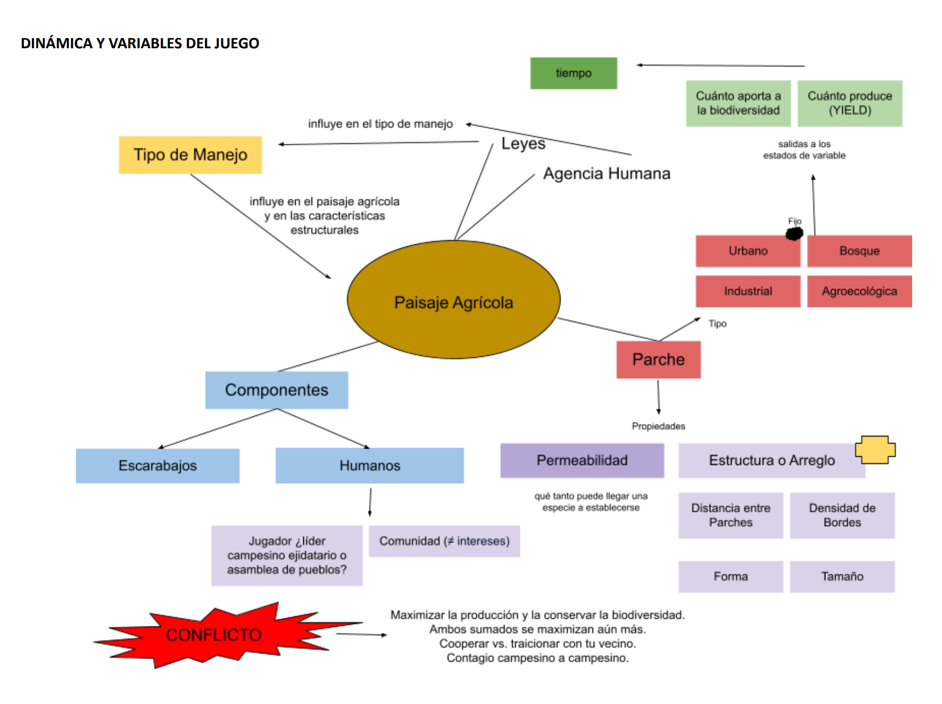
Agricultural Landscape
Patch/ Patch type
Variable states over time
Human/beetle components
Agency/laws, and land use
Permeability
Structural layout
Conflict

Slide 11
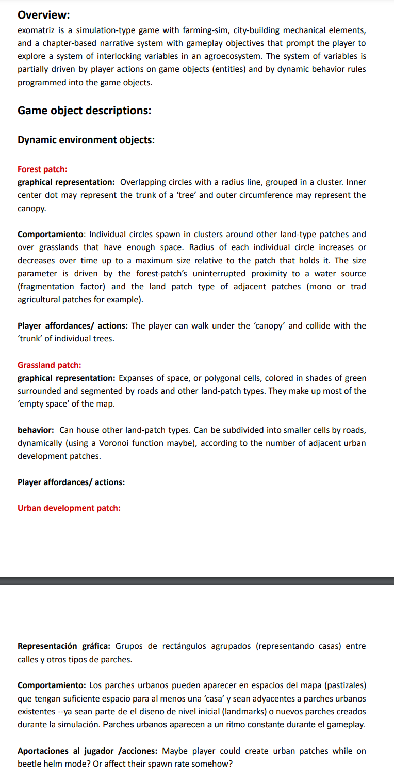
Design strategies
Descriptive writing approach.
Enforces clarity. Cristalizes abstract ideas.
Very time consuming and can still be not actionable enough.
No one is going to read it.
Good for ideation.
Focused systems diagrams.
Enforces visual representation.
Promotes simplicity.
Easy to show and explain.
Springboard for implementation.

Slide 12
Farmland subdivision

Slide 13
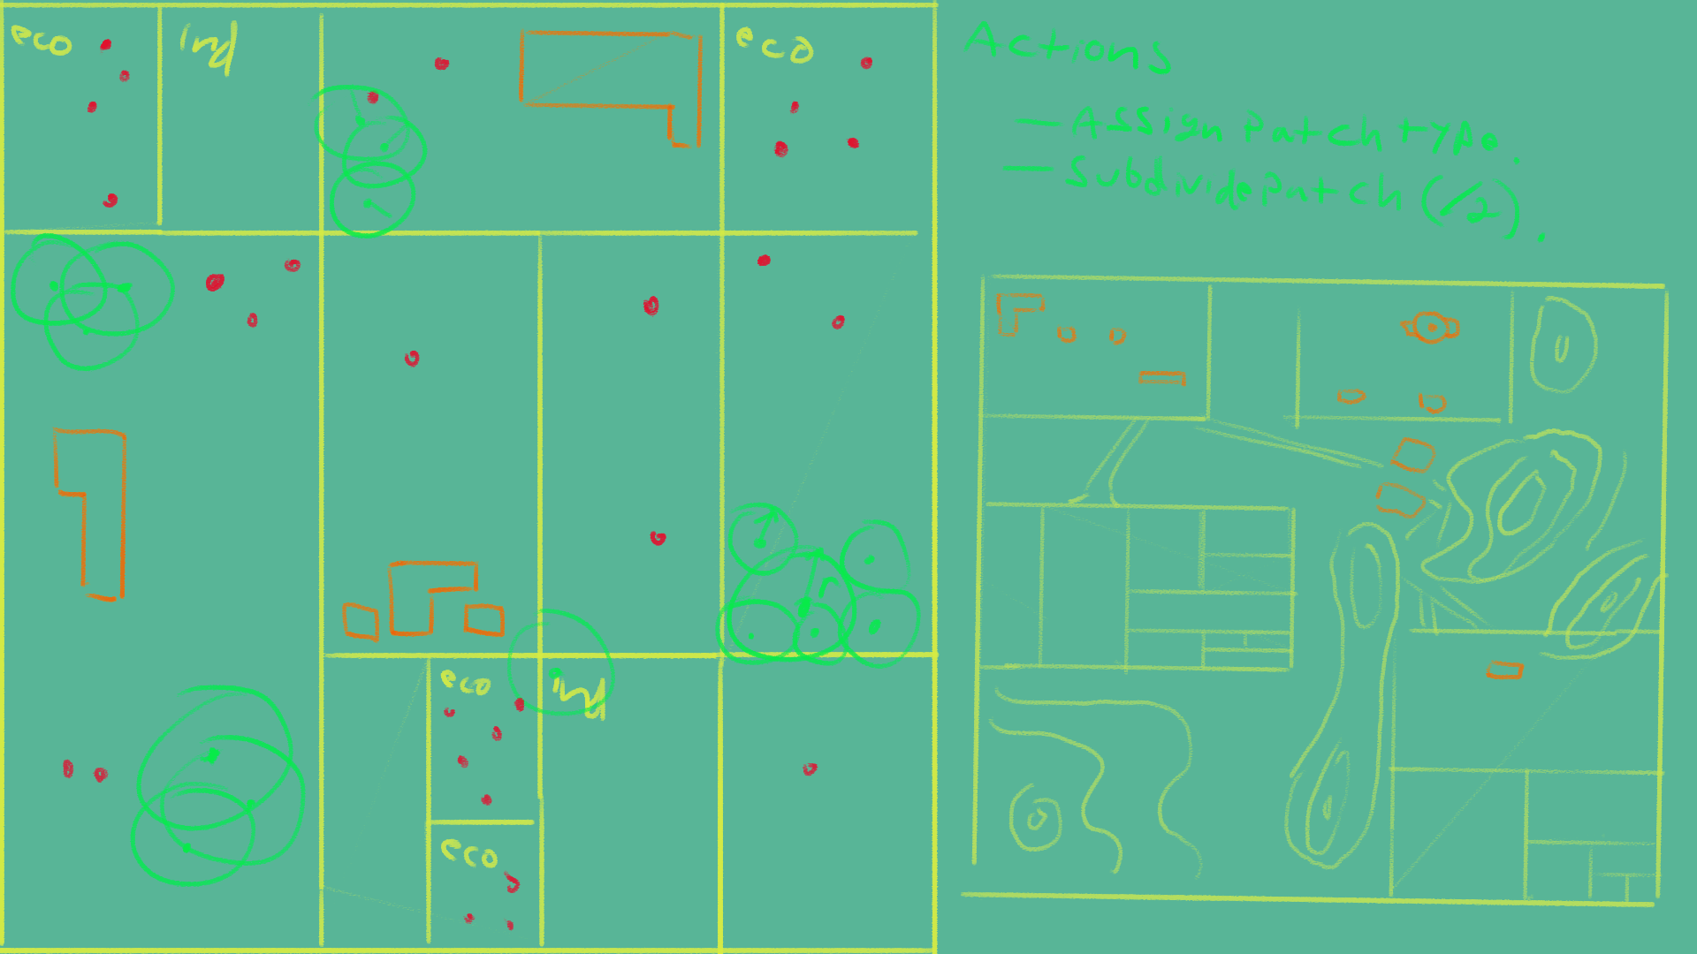

Slide 14
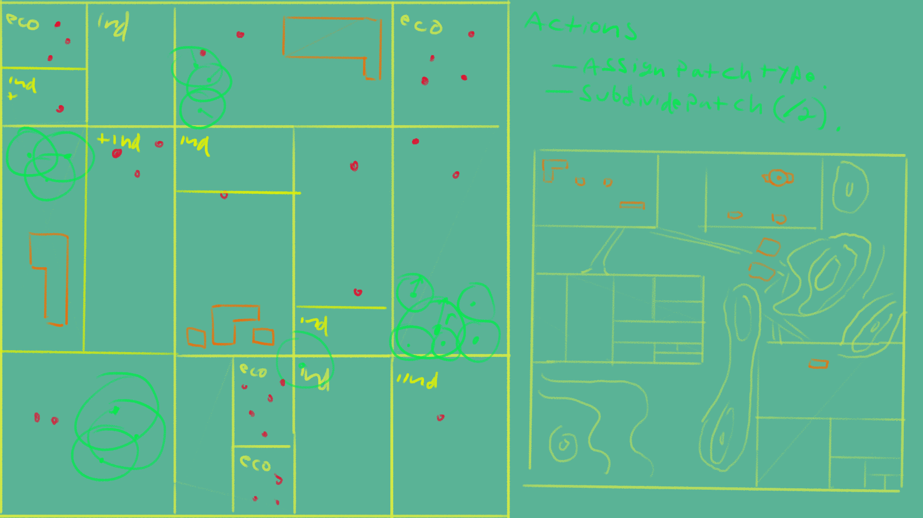

Slide 15
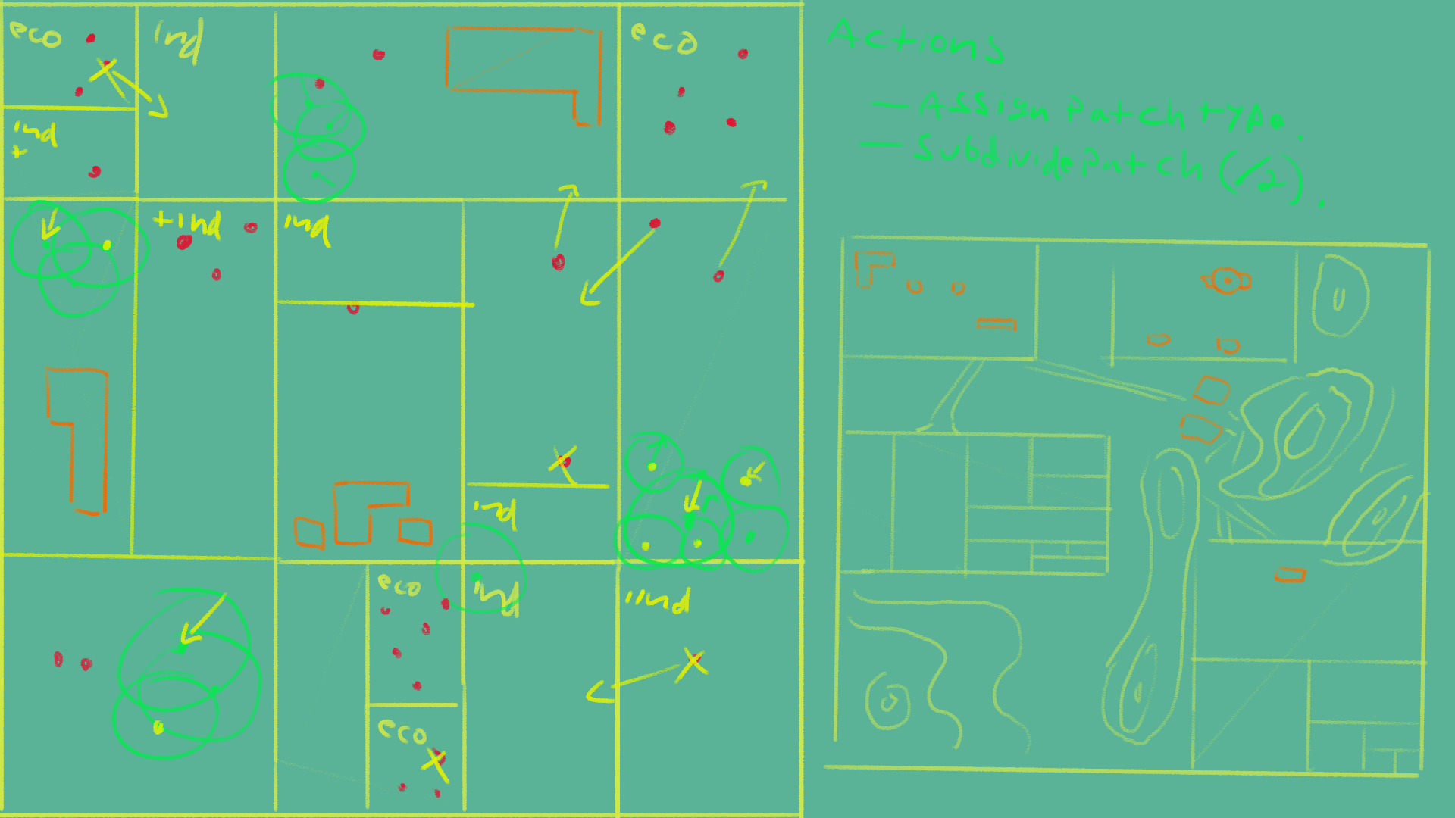

Slide 16
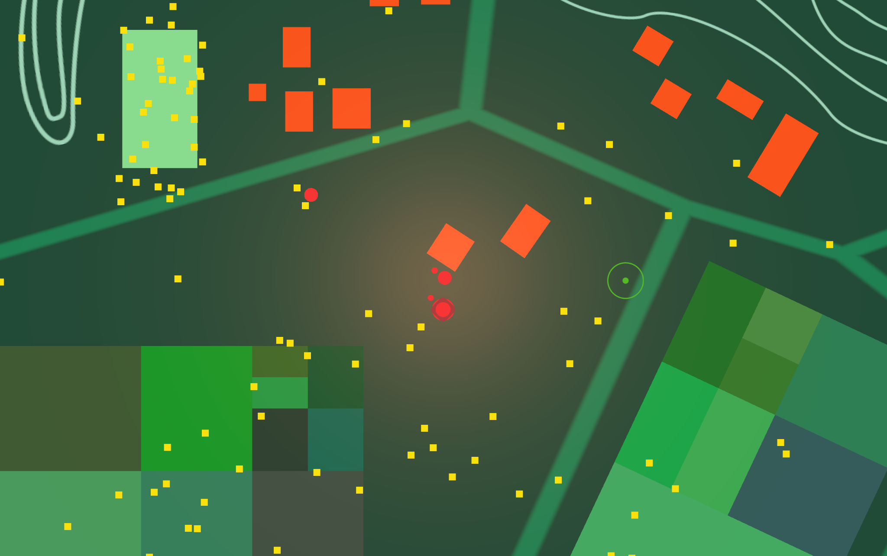
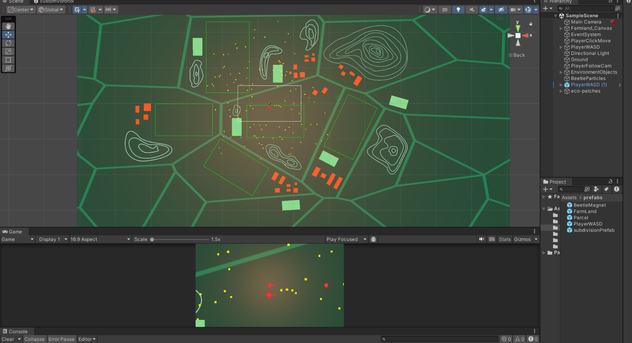
Demo

Slide 17
Sources
Ramos, I., González, C. G., Urrutia, A. L., Van Cauwelaert, E. M., & Benítez, M. Combined effect of matrix quality and spatial heterogeneity on biodiversity decline. Ecological complexity (2018) 36, 261-267.
Castro Campero, Lorena. Dinámica espacial de poblaciones de coleópteros en un paisaje agrícola heterogéneo en Oaxaca, México (2021). [Licenciatura en Biología] Universidad Nacional Autónoma de México.
González, C. G., García, T. L., Jardón-Barbolla, L., & Benítez, M.Linking Coleopteran Diversity With Agricultural Management of Maize-Based Agroecosystems in Oaxaca, Mexico (2020).
Stone Librande, One-Page Designs, GDC Vault, 2010, Accessed: 2023/12/05 https://www.gdcvault.com/play/1012356/One-Page.
Kaitlin Tremblay, Collaborative Worldbuilding For Videogames (2023). CRC Press.

